Slide 1
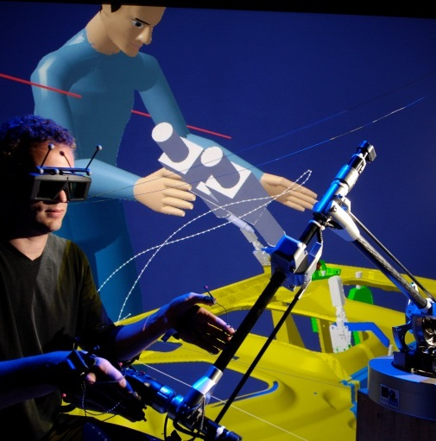
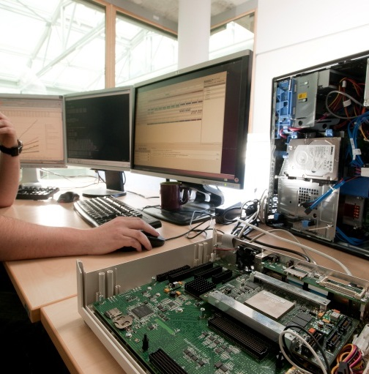
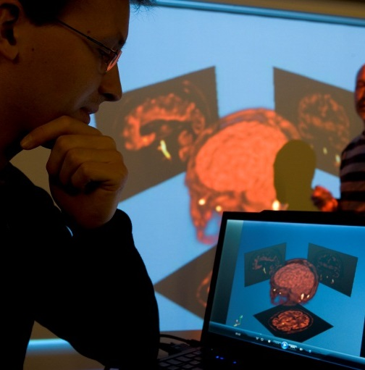
Foster software architect and programmer collaboration
Laboratory of Model-driven Engineering for Embedded Systems (LISE), CEA List, France
Presentation at 21th IEEE ICECCS 2016

Slide 2
Content
Synchronization processes
Round-trip IDE
Problematic
Experiments
Related work
Conclusion and future work

Slide 3

PROBLEMATIC
Model driven engineering (MDE)
Abstraction: diagram-based languages (models) for complex systems design
Automation: generation of code
Reticence of MDE adoption in industry [1] because:
Sharp perception gap between diagram-languages and textual languages
Software architects: favor the use of models
Software programmers: prefer familiar programming languages
A real need for model-code synchronization
Industrial need: update model or code in software evolution [1]
70 % update models
35 % update code and spend a lot of time to synchronize models and code
Majority of people said that keeping model-code synchronized is critical to the successful use of MDE
Scientific research directions:
Taylor pointed out: the need for adequate support for moving from architecture to implementation and fluidly moving between design and coding tasks [2]
Model-code consistency management [3]
[1] John Hutchinson, Jon Whittle, and Mark Rouncefield. 2014. Model-driven engineering practices in industry. Sci. Comput. Program. 89, PB (September 2014), 144-161. DOI=http://dx.doi.org/10.1016/j.scico.2013.03.017
[2] Taylor, Richard N., and Andre Van der Hoek. "Software design and architecture the once and future focus of software engineering." Future of
Software Engineering, 2007. FOSE'07. IEEE, 2007.
[3] Zheng, Yongjie, and Richard N. Taylor. "A classification and rationalization of model-based software development." Software & Systems Modeling 12.4 (2013): 669-678.
Notes:
-MDE is a development paradigm that relies on abstraction and automation, and seeks to increase productivity, by, among other things, increasing the level of automation
-

Slide 4


PROBLEMATIC
Design Model
Code generation
Code
Architect
Edit
Edit
Programmer
Design Model*
Consistency
Code*
How to synchronize concurrent editions made in model and code?
Notes:
Don't forget to say, even orally, that we wish to bridge the gap, therefore we face the challenge of synchronizing concurrently edited artifacts.

Slide 5
Content
Synchronization processes
Round-trip IDE
Problematic
Experiments
Related work
Conclusion and future work
Notes:
-I’m going to introduce our methodological pattern with a set of collaboration scenarios between software architects and programmers

Slide 6
Round-trip IDE
Actors and use-cases
Round-trip IDE
Reverse Code
Code reverse features
Reverse Code (Batch)
Reverse Code (Incremental)
Generate Code
Code generation features
Developer
Generate Code (Batch)
Generate Code (Incremental)
Synchronize Artifact
Model-model and code-code synchronization features
Synchronize Code
Synchronize Model
Edit Artifact
Model-driven Developer
Code-driven Developer
Edit Code
Edit Model
Software development actors
Artifact (mode/code) edition features
Notes:
-Our pattern consists of different actors and use-cases
-MDD actors: work mainly with models, software architects are specialization of MDD
-CDD actors: edit code, programmers
-Edit Model and Code allow to modify code and model respectively
It's actually model-model and code-code sync features (e.g. comparison, conflict resolution, reconciliation).

Slide 7
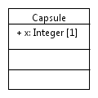
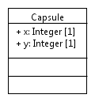
Round-trip IDE
Batch vs incremental code generation
Batch: Generate code from model, from scratch
Incremental: Update code by propagating changes from model to code
class Capsule {
int x;
}
add an attribute “y”
add a method “test”
class Capsule {
int x;
void test();
}
The method test is overwritten
Batch code
generation
Incremental code
generation
class Capsule {
int x;
int y;
}
class Capsule {
int x;
int y;
void test();
}
Notes:
I’m defining code generations:
Batch code gen:

Slide 8
Round-trip IDE
Batch reverse engineering: opposite to batch code gen.
Reconstruct model from source code from scratch
Overwrite any existing model
Incremental reverse engineering: opposite to incremental code gen.
Propagating changes from code to model

Slide 9
Content
Synchronization processes
Round-trip IDE
Problematic
Experiments
Related work
Conclusion and future work
Notes:
-Now, we have different use-cases in the pattern, I’ll explore collaboration scenarios for software architects and programmers

Slide 10
Synchronization processes
Usage scenario 1: programmer only edits code
Model
1
Generate Code (Batch)
Generated code
3
Reverse Code (Batch)
2
Edit Code
Edited
code
Notes:
In the first scenario, we consider the traditional development style in which only code is edited by the programmers during development
In the first step, code is generated from the model. After editions made in the code, in order to update the model, we use batch reverse engineering to update model

Slide 11
Synchronization processes
Usage scenario 2: architect edits model only
Model
1
Generate Code (Batch)
Generated code
2
Edit Model
3
Generate Code (Batch)
Edited model

Slide 12
Synchronization processes
Usage scenario 3: co-evolution of model and code
Model
1
Code Generation (Batch)
Generated code
Several possible strategies
We propose 2 strategies for either the programmer or the architect
2
Edit Model
3
Edit Code
Edited model
4
Synchronize Artifact
Edited
code

Slide 13
Synchronization processes
Synchronization artifact definition
Is an image of one of the artifacts, either the model or the code
Image = semantically equivalent copy specified in a different language
A synchronization artifact can be:
Code generated from an edited model
Model reconstructed from an edited code

Slide 14
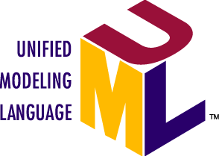
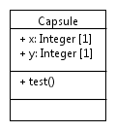
Synchronization processes
Strategy 1: Synchronization by creating a synchronization artifact as code
Edited model
1
Generate (Batch)
Sync. artifact (code)
2
Synchronize Code
Edited
code
3
Reverse (Inc.)
Illustration
Edited model
Edited code
Synchronization artifact
class Capsule {
int x;
void test();
}
1
Generate (Batch)
class Capsule {
int x;
int y;
}
2
Synchronize Code
Synchronized model
Synchronized code
class Capsule {
int x;
int y;
void test();
}
3
Reverse (Inc.)

Slide 15
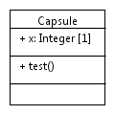
Synchronization processes
Strategy 2: Synchronization by creating a synchronization artifact as model
Edited model
2
Synchronize Model
Sync. artifact (model)
1
Reverse (Batch)
Edited
code
3
Generate (Inc.)
Illustration
Synchronization artifact
Edited model
Edited code
1
Reverse (Batch)
class Capsule {
int x;
void test();
}
2
Synchronize Model
Synchronized model
Synchronized code
class Capsule {
int x;
int y;
void test();
}
3
Generate (Inc.)

Slide 16
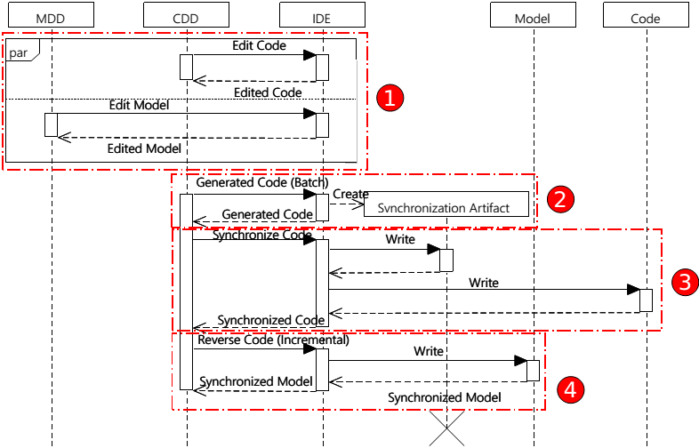
Synchronization processes

Slide 17
Content
Synchronization processes
Round-trip IDE
Problematic
Experiments
Related work
Conclusion and future work

Slide 18
Experiments and evaluations
Experiments
Implementation
Evaluations
Evaluation 1: Reverse unedited code
Case-study: Papyrus-RT runtime
Evaluation 2: Reverse edited code
Evaluation 3: Concurrent editions in model and code

Slide 19





Experiments and evaluations
Implementation
Papyrus
Eclipse CDT
Generate Code (Batch)
Synchronize Code
Edited Model
1
Synchronization Artifact (Code)
2
Edited Code
Reverse Code (Incremental)
3
Papyrus + CDT
Papyrus
Synchronize Model
Reverse Code (Batch)
Modified Model
2
Synchronization Artifact (Model)
1
Edited Code
Generate Code (Incremental)
3
EMF Compare
Papyrus + Viatra

Slide 20
Experiments and evaluations
Evaluation 1: Reverse unedited code
Right-invertibility: full round-trip of UML model and code
Random UML models are generated by a configurable generator
Each model:
3 packages
60 classes, around 10 enumerations, 10 structures, 10 function pointers/package
Methods, attriutes, and relationships
Randomly Generate Model
1
Generated Model
Generate Code (Batch)
Code from Generated Model
2
Compare Model
Reverse Code (Batch)
4
3
Reversed Model
Results:
200 models are generated
No differences
Right-invertibility is verified by simulation

Slide 21
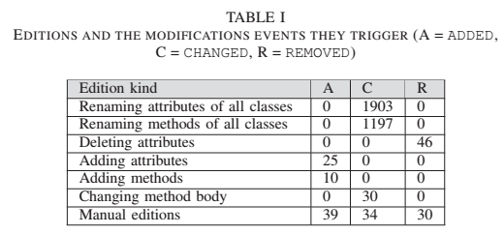
Experiments and evaluations
Evaluation 2: Reverse edited code
Left-invertibility: full round-trip with editions in code
Models generated above are used
1
Randomly Generate Model
Generated Model
Generate Code (Batch)
Code from Generated Model
2
4
Reverse Code (Inc.)
6
Compare Model
3
Edit Code
Model from Edited Code
Reverse Code (Batch)
Edited Code
5
Results:
200 models are generated
No differences
Left-invertibility is verified by simulation

Slide 22
Experiments and evaluations
Evaluation 3: Concurrent editions
Emulation of synchronization process
Model editions: attribute renaming
Code editions: method bodies
1
Randomly Generate Model
Generated Model
2
Generate Code (Batch)
Generated Code
3
Edit Model
4
Edit Code
Synchronize and Assess
Synchronized Code
Edited Model
Edited Code
Synchronized Model
5
Results: Two strategies for synchronization applied to 200 models
Synchronized Model is compared with model reversed from Synchronized Code
No differences found
Our approach is able to synchronize model and code in case of concurrent editions

Slide 23
Experiments and evaluations
Case study: Papyrus-RT runtime
Evaluation purpose:
The usability of the proposed synchronization approach
The scalability of the tooling to a real system
A real need for synchronization for Papyrus-RT runtime development
Papyrus-RT:
Papyrus-based modeling tool supporting embedded system design in UML
Featuring full automated C++ code generation for UML models
Generated code executed within a C++ runtime environment
Development team:
C/C++ programmers at the beginning
Want to benefit MDE to improve maintainability + evolvability
New developers favor the use of models for development
Current MDE adoption
UML-RT code is manually reversed to a Papyrus UML model and code is generated
The task is “long” and “tedious”
In the mean time model and code evolved concurrently

Slide 24
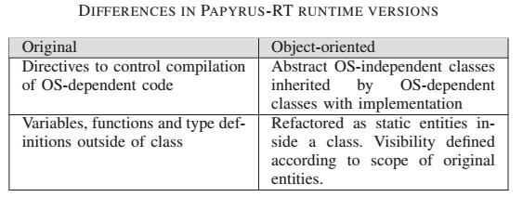
Experiments and evaluations
Case study: Papyrus-RT runtime
Adoption of synchronization approach:
C/C++ runtime code
Source code refactoring
C++ Runtime code
Reverse engineering
UML
Code generation
Comments
C++ profile
C+ Generated runtime code
Conversion to fully object-oriented
65 classes and 14,945 lines of code
Binary: 421KB
65 classes and 22,053 lines of code
Binary: 377KB
Inputs for concurrent development + synchronization
Notes:
Objects size (total):
Original : 421Ko
Generated: 377Ko

Slide 25
Experiments and evaluations
Case study: Papyrus-RT runtime
Advantages:
Automatic handling of relationships between model elements, i.e. association, dependency, inheritance
Automatic generation of includes and forward declarations in the code that avoids cyclic dependencies
Graphical representation of architecture in automatically updated UML diagrams (feature of Papyrus)
Difficulties to apply the synchronization processes
Initializing the synchronization
Refactoring non-object-oriented to fully object-oriented code

Slide 26
Content
Synchronization processes
Round-trip IDE
Problematic
Experiments
Related work
Conclusion and future work

Slide 27
Related work
Round-trip engineering: model and code
Model synchronization

Slide 28
Related work
Round-trip engineering: model and code
Industrial tools: IBM Rhapsody, Enterprise Architect…
No mechanisms for synchronization of concurrently modified model and code
Lack of dependencies derived from method bodies
Partial round-trip engineering + protected regions: separate the code regions generated from models from regions which are allowed to be edited by programmers.
Uni-directional round-trip engineering ➔ no support for iterative development

Slide 29
Related work
Model synchronization
Triple Graph Grammar + QVT-Relation: synchronization of models from a specification
Need explicit traceability links
For synchronization, editing one model requires the presence of the other
Bi-directional transformation: generate a backward from forward transformation
No means to synchronize concurrently edited models
ATL-based synchronization: model synchronization derived from model transformation
Technology-dependent
Addition of an element in target model is not well handled
Abductive programming-based approach: analyze and propagate changes from one artifact to the other
One-way synchronization
Not clear how this approach can handle the concurrent modification problem

Slide 30
Content
Synchronization processes
Round-trip IDE
Problematic
Experiments
Related work
Conclusion and future work

Slide 31
Conclusion and Future Work
Contribution
A model-code synchronization methodological pattern
An Eclipse-based implementation for synchronizing UML and C++
Validation
Both laws of round-trip engineering are assessed through simulations
Synchronization of concurrent modifications is assessed
Successful application to a case study: Papyrus-RT runtime
Future work
Application to synchronization of UML composite and state machine diagram concepts and object-oriented code
Instantiation of the approach for other languages like Java and for other technological frameworks (instead of Eclipse)

Slide 32


Slide 33
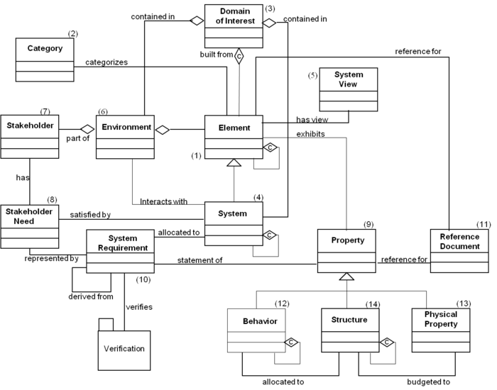
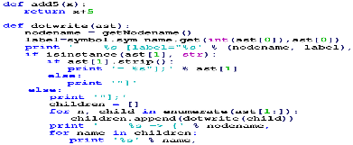
Problematic
Model Driven Engineering (MDE)
Retecence of MDE adoption
Problem understanding
Communication
Code generation
Simulation
Testing
Evolution: Updating models or code?
70 % update models
40 % update code and spend a lot of time to synchronize models and code
Majority of people said that keeping model-code synchronized is critical to the successful use of MDE
[1]
Automation
Abstraction
Compilation
Complex System
[1] Davide Di Ruscio et al, Model-driven engineering practices in industry: Social,
organizational and managerial factors that lead to success or failure
Notes:
-MDE is a development paradigm that relies on abstraction and automation, and seeks to increase productivity, by, among other things, increasing the level of automation
-

Slide 34
Content
Collaboration scenarios
Papyrus-RTE: Conceptual Framework
Problematic
Papyrus-RTE: Concrete Framework
Experiments
Related work
Conclusion and future work

Slide 35
Motivating Case Study: UML-RT
A real need for round-trip engineering
Previously, UML-RT runtime code was manually reversed to a Papyrus UML model and code was generated
The task was “long” and “tedious”
In the mean time model and code evolved concurrently
Papyrus offer for round-trip engineering
UML modeler and C++ code generator are released…
…but reverse and incremental update tool are still in development
!
A real problem of synchronization

Propose an IDE Papyrus-RTE for C++ round-trip engineering
Notes:
We handle C++ and not C
We try to transform C to some object-oriented model but we don’t guarantee total reverse of C at the moment

Slide 36
Code generation definitions
Incremental code generation
Update existing code by propagating changes from model to code
class Capsule {
int x;
}
add y
add test
class Capsule {
int x;
void test();
}
test is kept
Batch code
generation
class Capsule {
int x;
int y;
void test();
}
Notes:
Incremental code gen

Slide 37
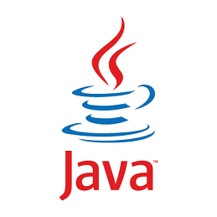
Collaboration scenarios
Scenario 3.1: merge by creating a synchronization artifact as code
Edited model
1
Generate (Batch)
Sync. artifact (code)
2
Synchronize Code
Edited
code
3
Reverse (Inc.)
Edited model
Edited code
Synchronization artifact
class Capsule {
int x;
void test();
}
1
Generate (Batch)
class Capsule {
int x;
int y;
}
2
Synchronize Code
Synchronized code artifact
class Capsule {
int x;
int y;
void test();
}
3
Reverse (Inc.)

Slide 38
Experiments and evaluations
Simulation
Test Papyrus-RTE respects the round-trip engineering laws
Right-invertibility: If no editions are made to the code, the model used for generating the code and the model received by immediately reversing the generated code must be the same.
Left-invertibility: All editions on the code are captured and correctly propagated to the model so that the edited code can be fully recreated by applying code generation to the updated model.

Slide 39
Experiments and evaluations
Evaluation 1
Right-invertibility: Illustration
Randomly Generate Model
1
Generated model
Code from Generated Model
class Capsule {
int x;
int y;
}
Generate Code (Batch)
2
Results:
200 models are generated
No differences
Reverse Code (Batch)
Compare Model
3
5
Reversed Model

Slide 40
Experiments and evaluations
Evaluation 2
Right-invertibility: Illustration
Randomly Generate Model
Code from Generated Model
1
Generated model
class Capsule {
int x;
int y;
}
Generate Code (Batch)
2
3
Edit Code
Compare Model
4
Reverse Code (Inc)
class Capsule {
int x;
int y;
void test();
}
Edited code
6
Model from Edited code
5
Reverse Code (Batch)
Results:
200 models are generated
No differences

Slide 41
Experiments and evaluations
Evaluation 2
Left-invertibility: Results
Editions introduced to code
200 models are tested
No differences were found during model comparison and code comparison

Slide 42
Synchronization processes
Illustration
Edited model
Edited code
Synchronization artifact
class Capsule {
int x;
void test();
}
1
Generate (Batch)
class Capsule {
int x;
int y;
}
2
Synchronize Code
Synchronized model
Synchronized code
class Capsule {
int x;
int y;
void test();
}
3
Reverse (Inc.)

Slide 43
Synchronization processes
Illustration
Synchronization artifact
Edited model
Edited code
1
Reverse (Batch)
class Capsule {
int x;
void test();
}
2
Synchronize Model
Synchronized model
Synchronized code
class Capsule {
int x;
int y;
void test();
}
3
Generate (Inc.)

